Slide 1
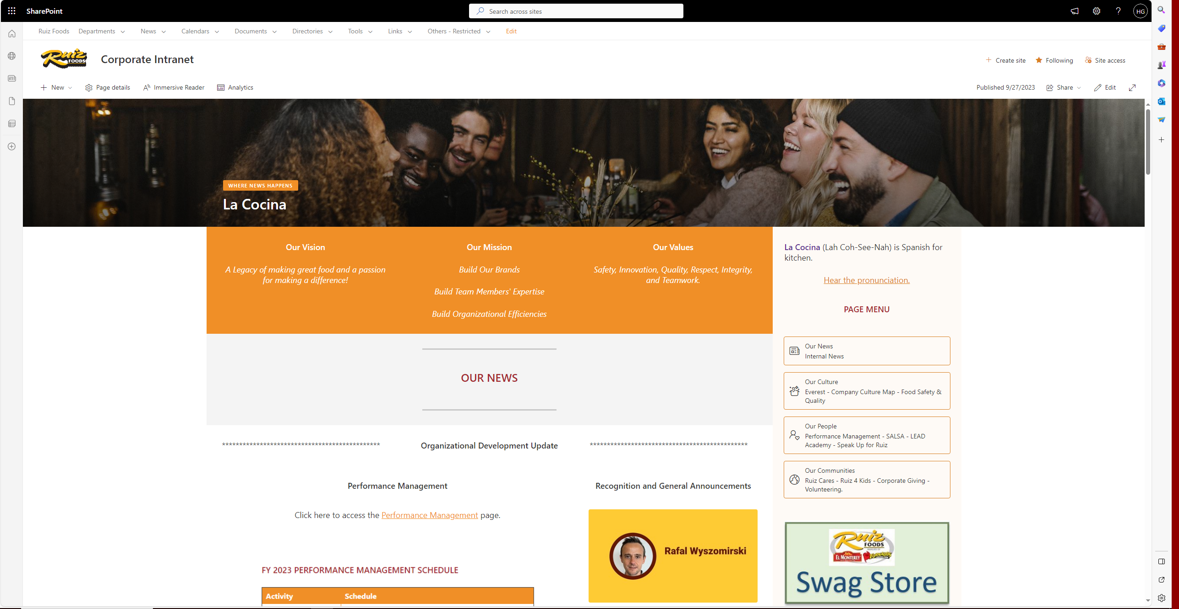
Current Corporate Intranet Home Page as September 2023

Slide 2
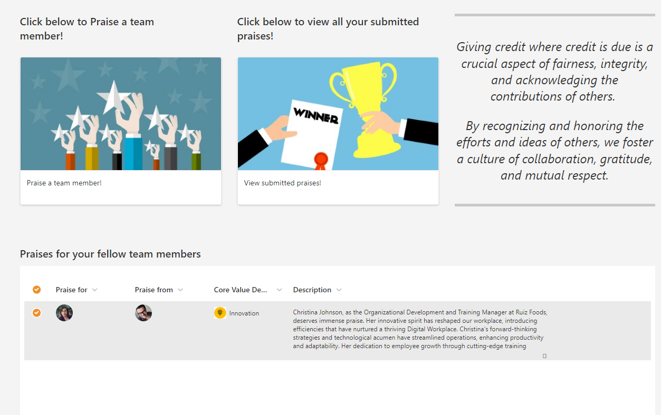
New section will be added to home page

Slide 3
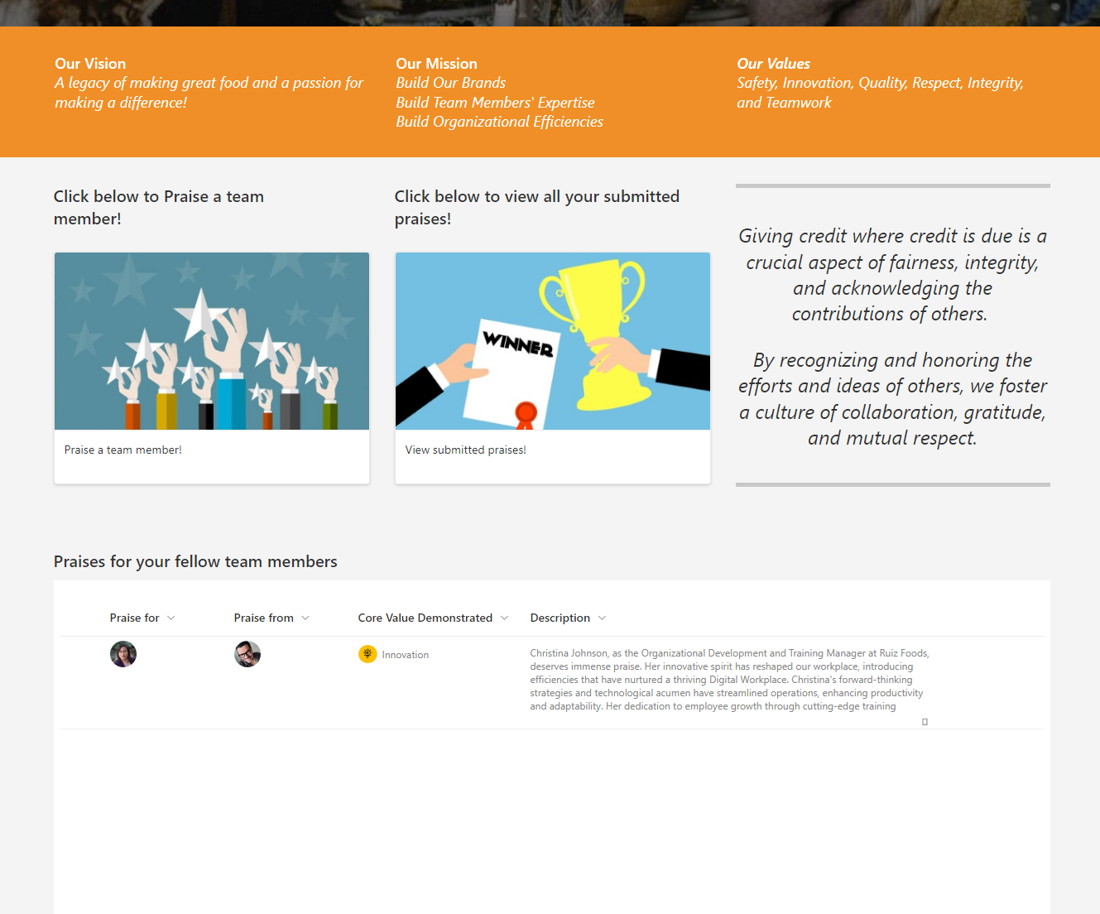
Welcome to the Praise Program
The purpose of the Praise Program addition to La Cocina is to allow team members to recognize each other for great teamwork, ideas, process improvements, and any other work or community activity for which the submitter deems worthy of recognition.

Slide 4

Features
Ruiz Foods Employees
Praise a team member is an option for submits praise recognitions
View submitted praises is an option to review submitted and approved Praises
Praise Team
Review and evaluate Praise request
If praise approved
Praise is sent by email to requestor and published in the Corporate Intranet Home Page for 7 days, then Praise is archived
If praise declined
Feedback is sent to requestor
Requestor can resubmit declined praise

Slide 5
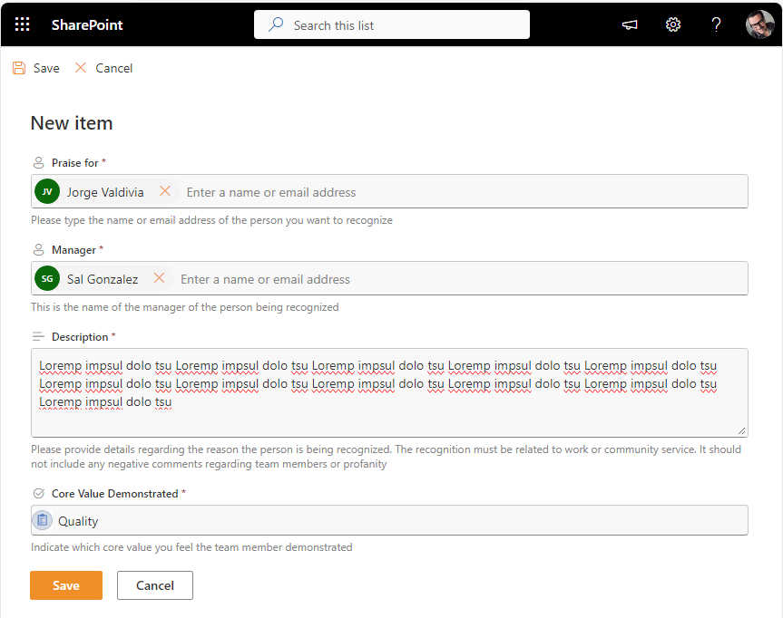
Praise a team member!
Praise for
Manager
Description
Core Value Demonstrated

Slide 6
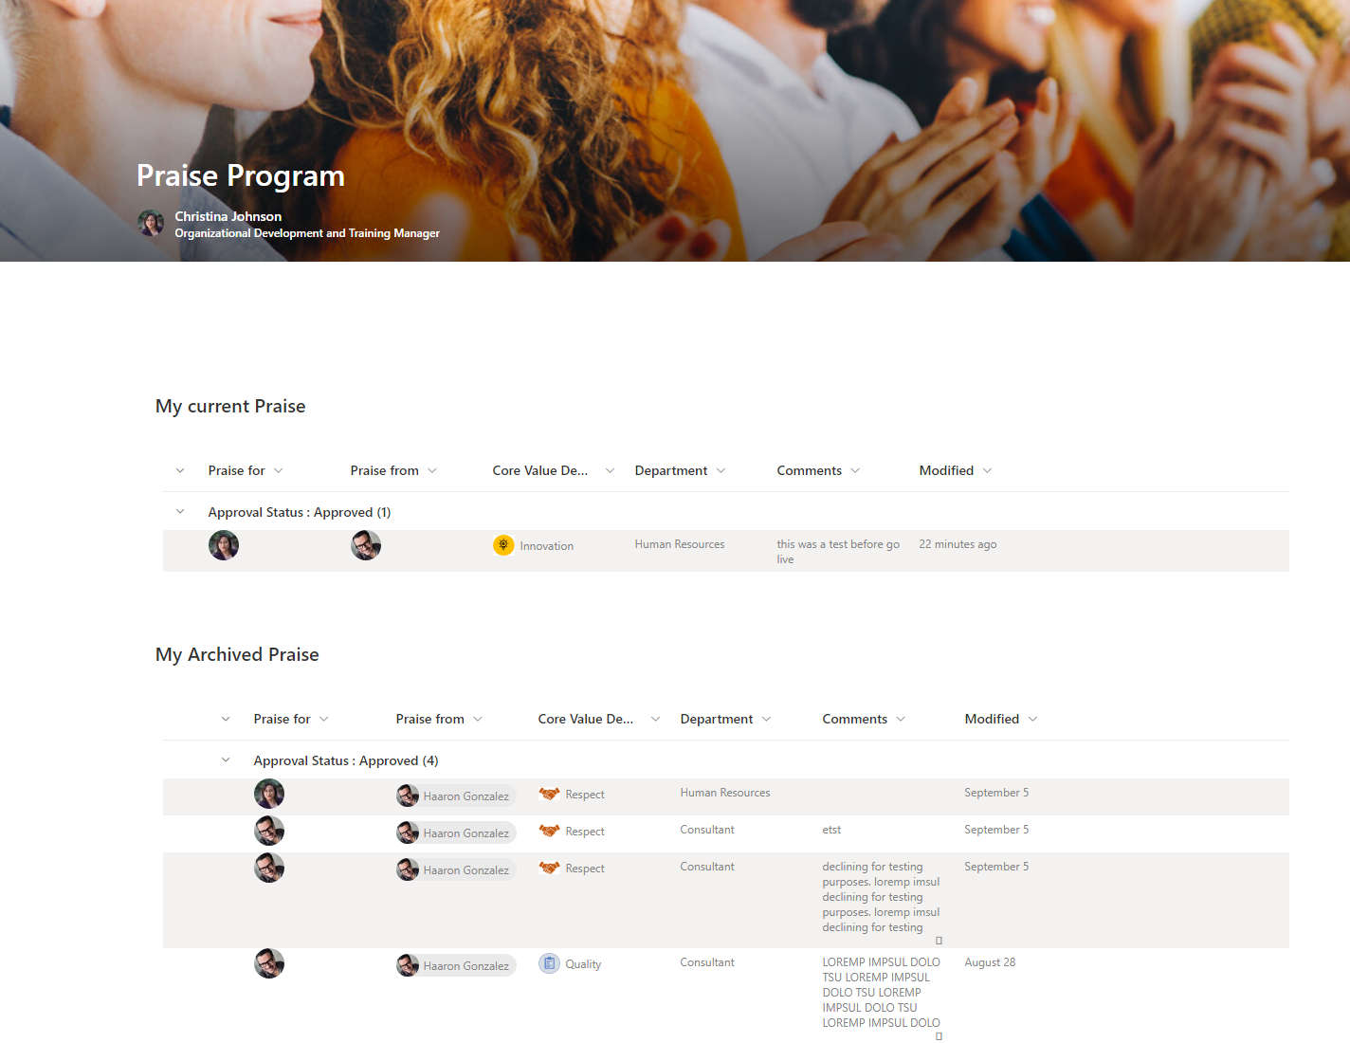
View submitted praises!
My current praise
Will take 7 days to be highlighted in the home page
My archived praise
After 7 days praises archived

Slide 7
Praise evaluation and approval
Ruiz User submits a Praise request
Automation send email to requestor and start an approval request
Praise team member reviews praise request and approves of declines
If praise request approved, congratulations email is sent to the praised person and CC manager
If praise request decline, feedback is sent by email to requestor, he can re submit
Review and evaluate Praise request
If praise approved
Praise is sent by email to requestor and published in the Corporate Intranet Home Page for 7 days, then Praise is archived
If praise declined
Feedback is sent to requestor
Requestor can resubmit declined praise

Slide 8

Go Live
Sunday October 1st
Test data will be removed from the Praise (Archive) list
Backup the current Corporate Intranet Home Page (La Cocina)
Edit the Corporate Intranet Home Page (La Cocina) to include the new section web parts and verbiage
Publish the new version of the Corporate Intranet Home Page (La Cocina)
Support Mode start on October 2nd
Keep an eye of submitted request
Ensure underlying solution components and automation works as expected
Be available for any support required

Slide 9
Technical Details
Automation runs under o365-pa-flowsvc@ruizfoods.com
Data is saved in two SharePoint lists under the Corporate Intranet portal
Praise
Praise (Archive)
Microsoft Teams
Use underlying Approval feature

